Slide 1
Insurance Management System
Group Number - 3
Team Lead : Manish Sakalkar & Frontend Lead: Aishwarya Ankalagi
Backend Lead : Manish Sakalkar

Slide 2
Team Members:
2490829 Bandi Reddama
2490000 Dara Pavani
2491302 Gangasani Lokesh
2491403 Mk Sahana
2490856 Aishwarya Ankalagi
2489813 Bandi Keerthi
2490641 Gowtham V
2491258 Manish Chandrakant Sakalkar
2487417 Para Jhansi
2488690 Sridatta R Patil

Slide 3
Content
Abstract
Introduction
Proposed system
Technology used
Modules
ER Diagram
Use Case Diagram
Output
Advantages
Conclusion
Future Scope

Slide 4
Abstract
This is a web project. It uses a centralized database to manage entire data of insurance office. This application allows user to maintain record of their policy and insurance related details. There is one main user who has control over each and every module of Insurance management system project All master data like policy is entered by admin apart from registering all insured customers data and master record this system allows admin to delete unwanted records from the database

Slide 5
Introduction
An Online Insurance management system is a web application is developed for tracking the details of the insurance policy, customer details and company details. This website is an online insurance Analysis and information management system that provides easy access to information regarding the people and resources of insurance.
This project is useful for any kind of insurance company to manage the insurance details, to sanctioned the insurance for the customer, process the insurance policy details and all kind of insurance process through online.

Slide 6
Proposed System
The proposed system is for making it easier to manage policyholder details, agent details, policy details, claimant details and payment details.
This insurance management system will be developed for managing the insurance management system. The overall system is controlled through the main menu.
It is designed by keeping to eliminate the drawbacks of the present system to provide a permanent solution to the problems.

Slide 7
Technologies Used
Operating System: Windows 10
Application Type: Web Application
Development Tools: Visual Studio and Spring Boot
Database : SQL Server
Language: Angular – Frontend design
Spring-Boot(Java) - Backend
Jasmin - Unit Testing
Postman – For Functional testing
SQL – Storing Database

Slide 8
Modules:
Login Module: Used for managing the login details
Admin Module: Used for managing policy details, category details and customer information.
Customer Module: Used for managing the Customer details.

Slide 9
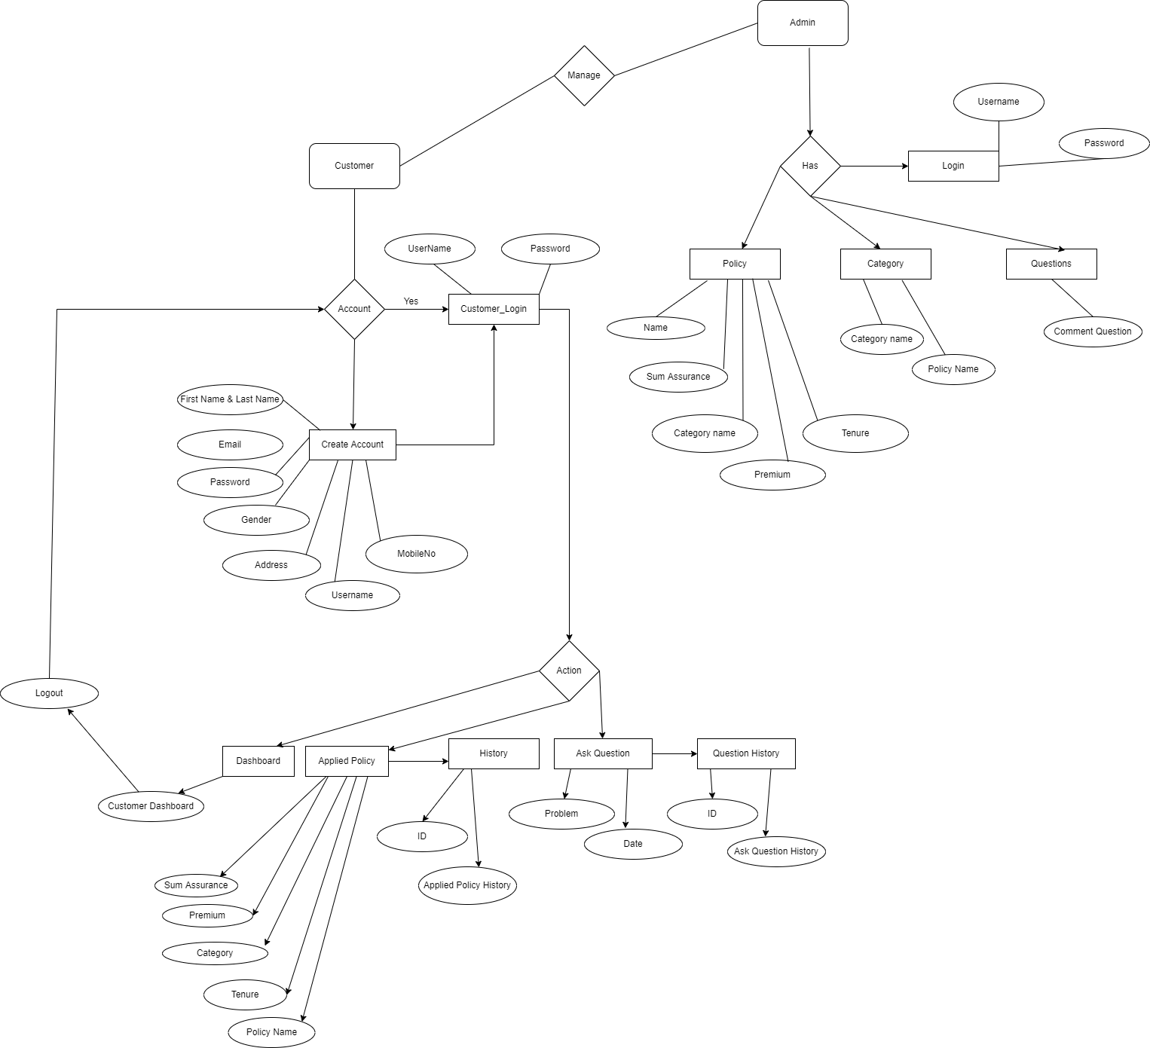
ER Diagram

Slide 10
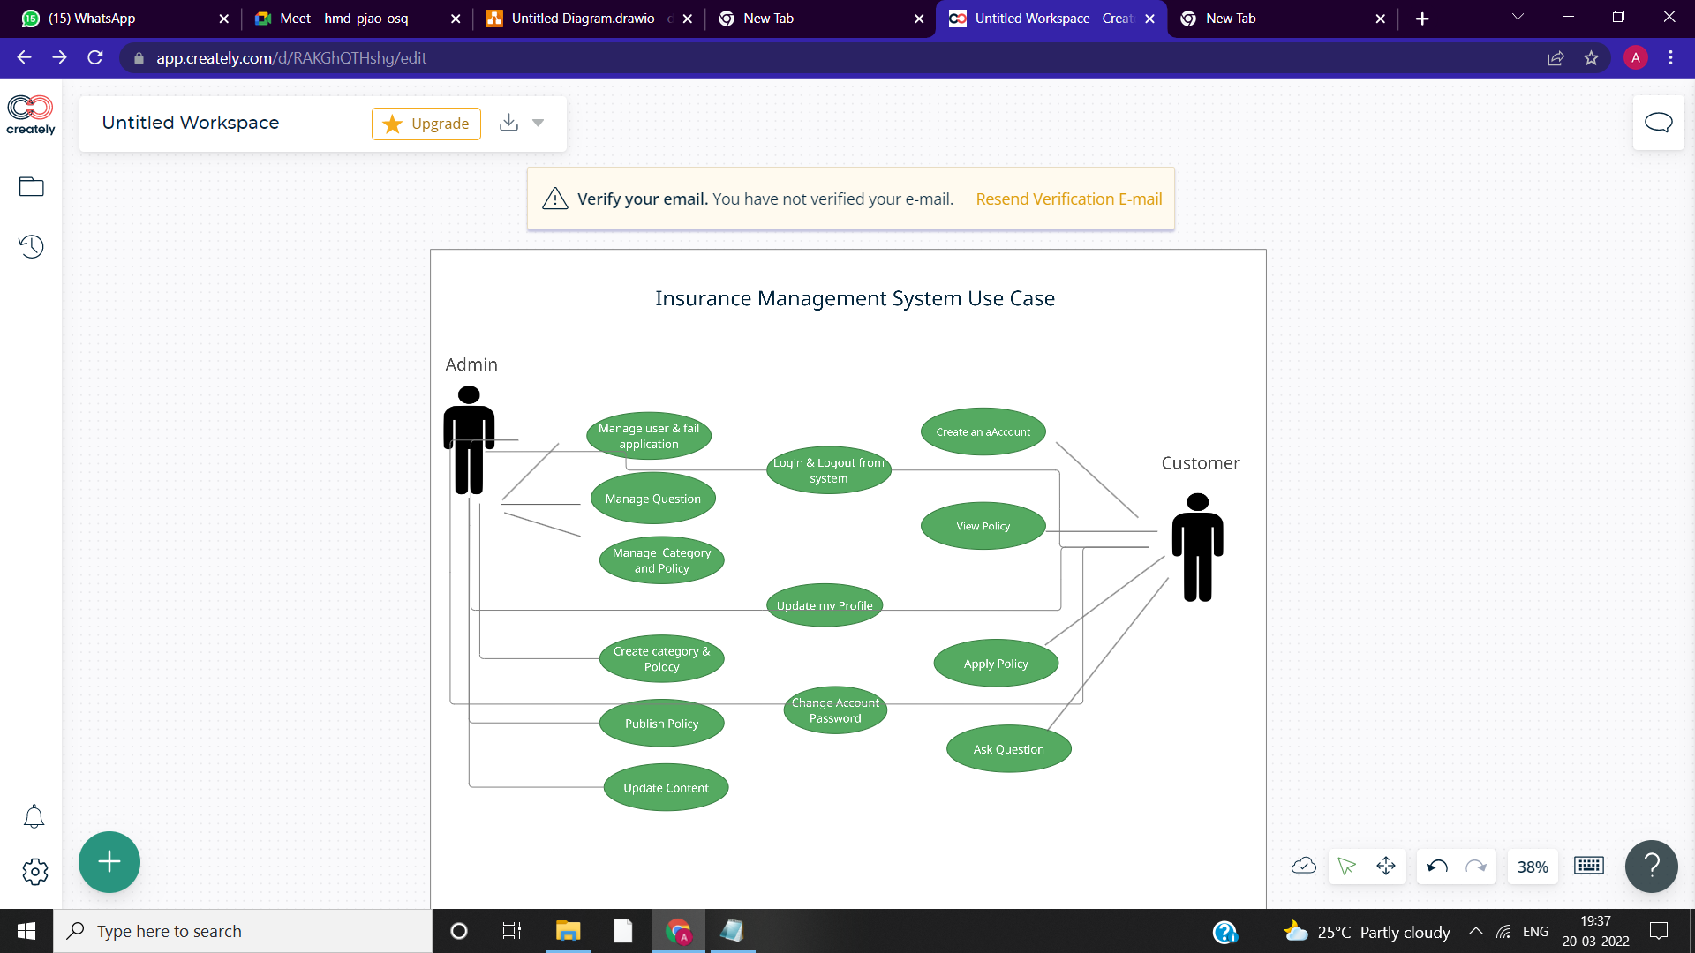
Use Case Diagram

Slide 11
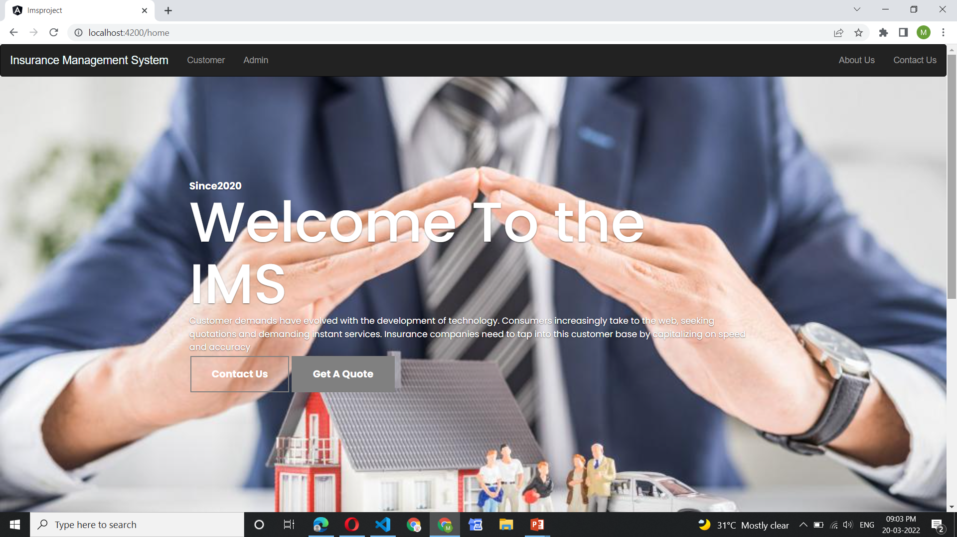
Screen Shots
Home Page

Slide 12
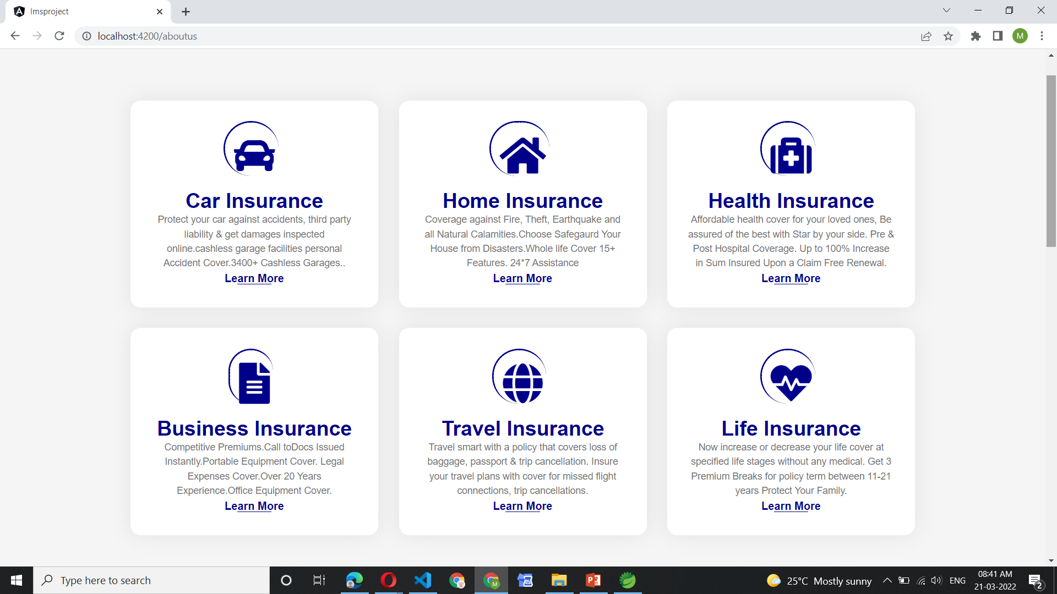
About US

Slide 13
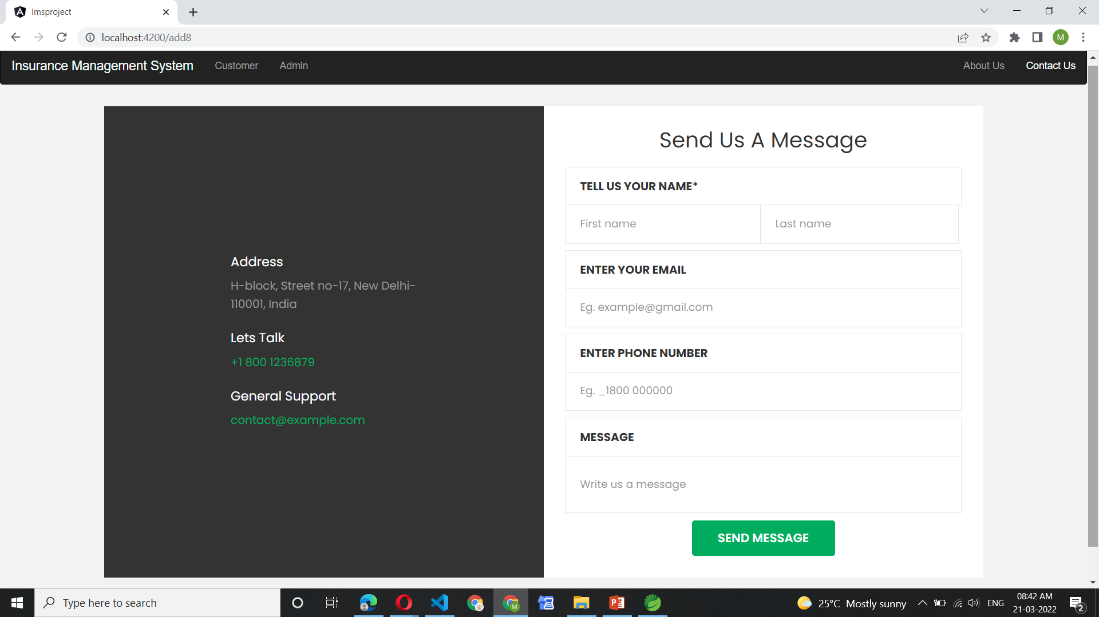
Contact US

Slide 14
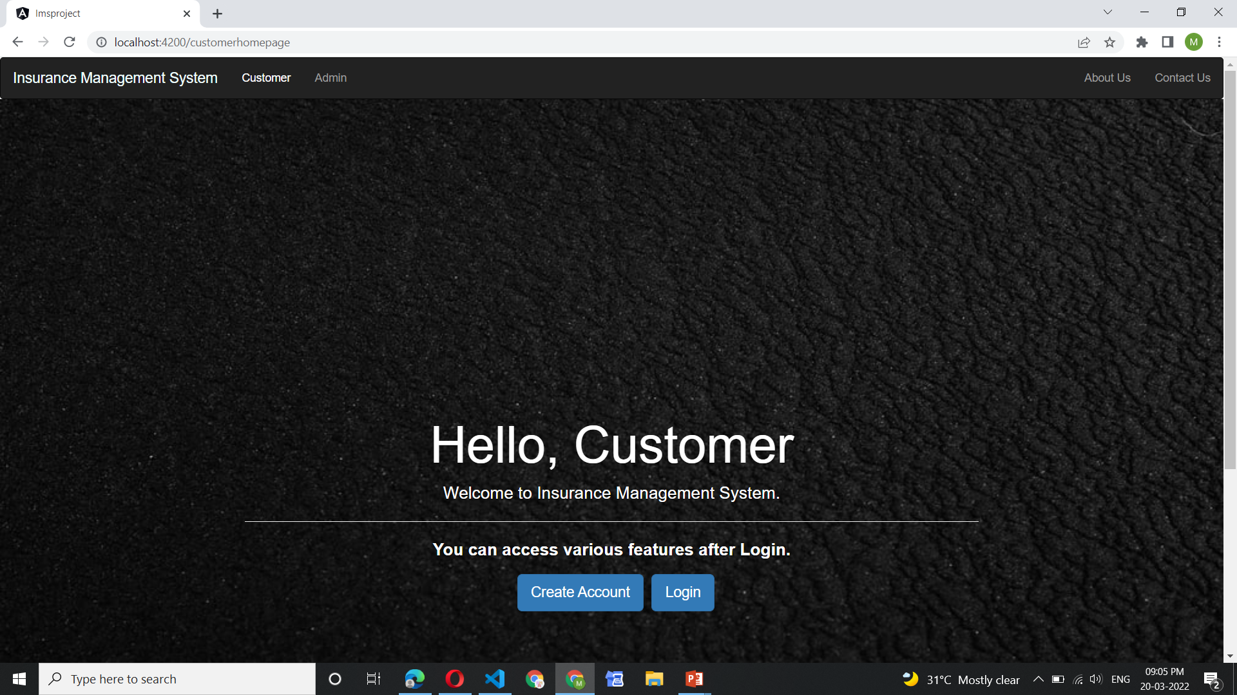
Customer Home Page

Slide 15
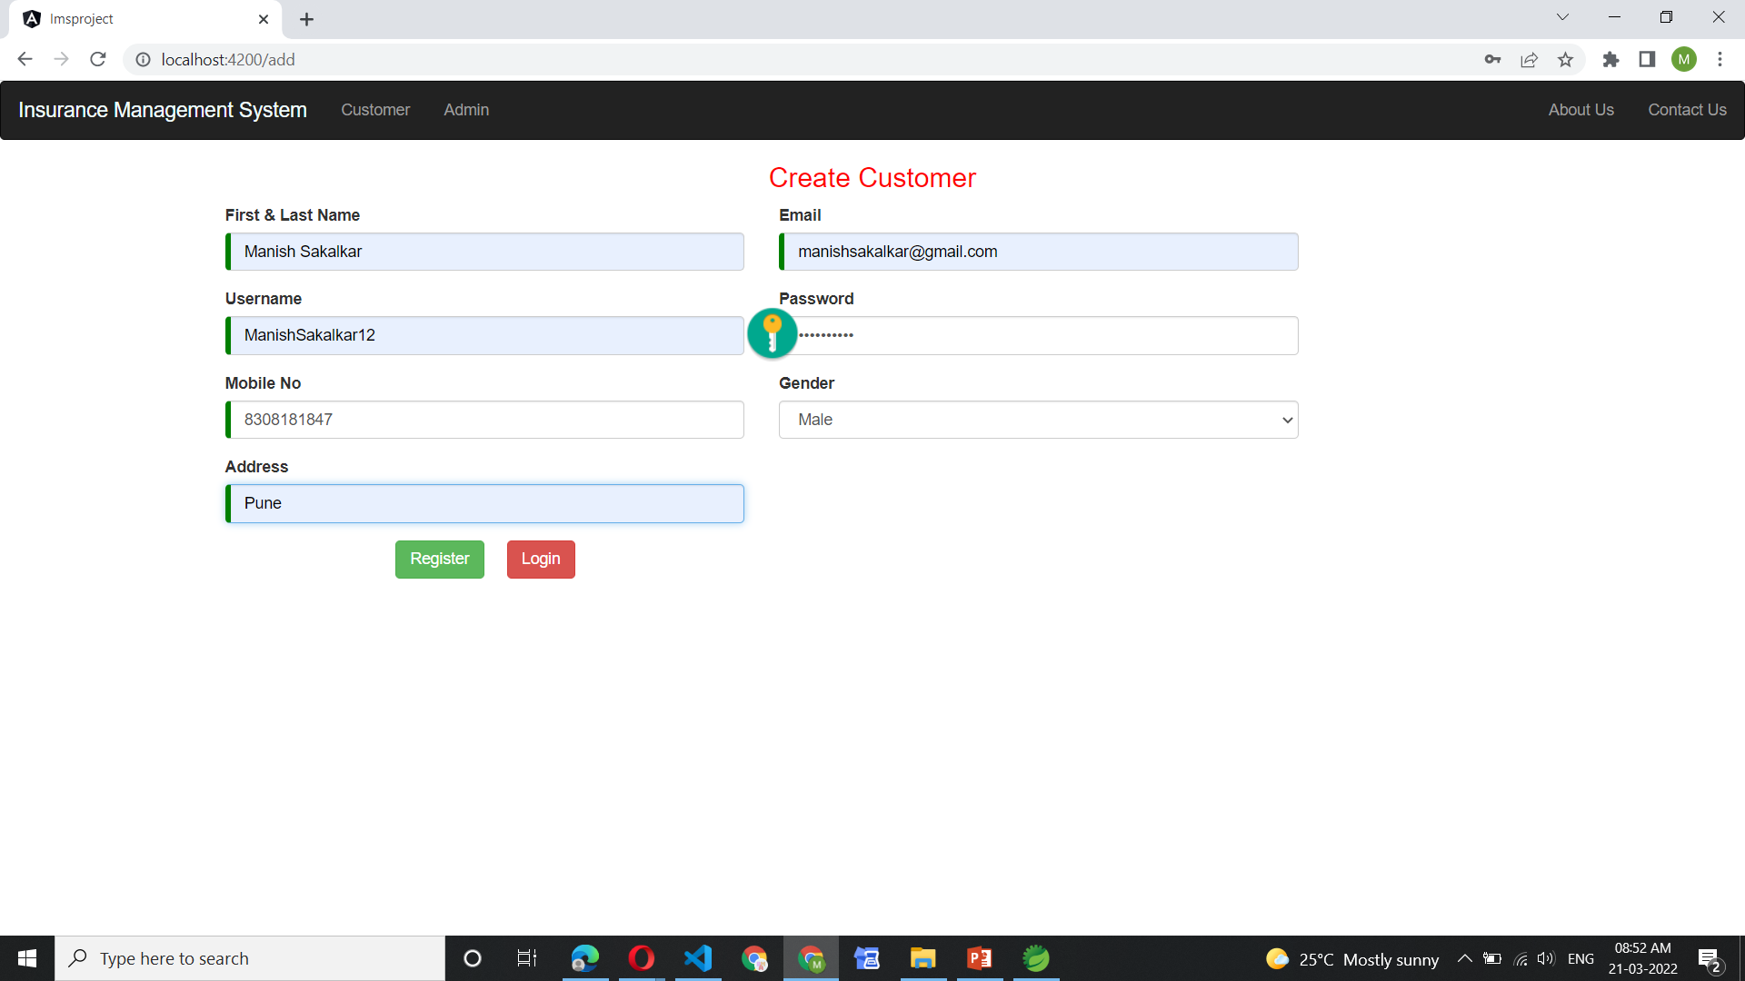
Create Account for Customer

Slide 16
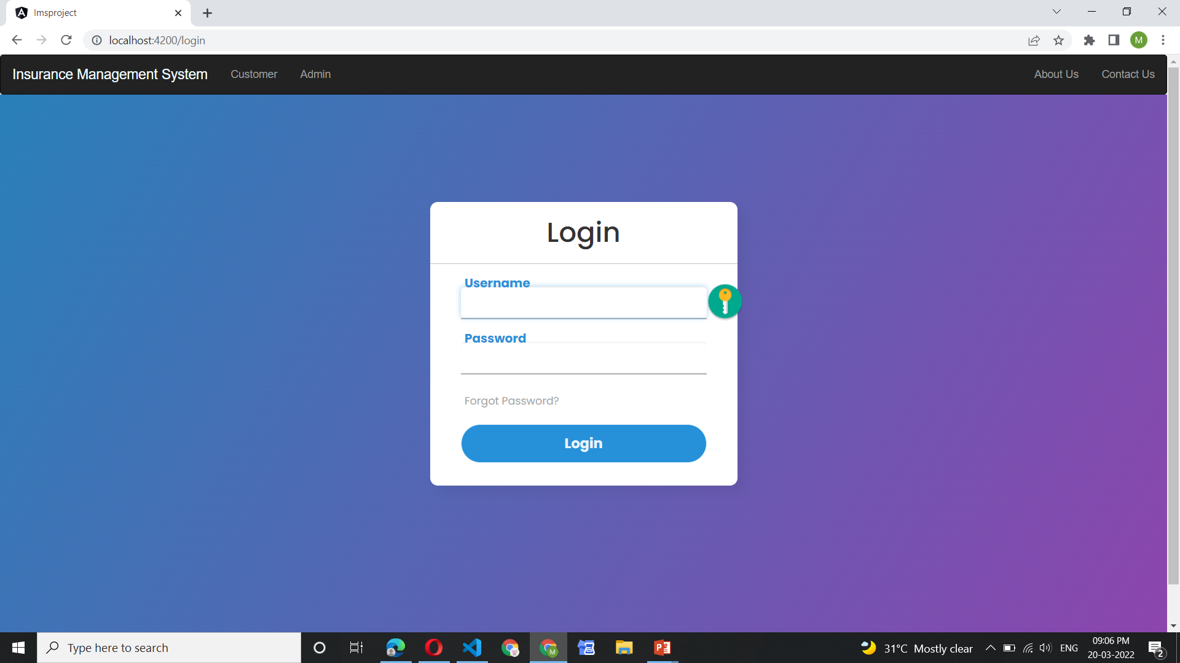
Login Customer

Slide 17
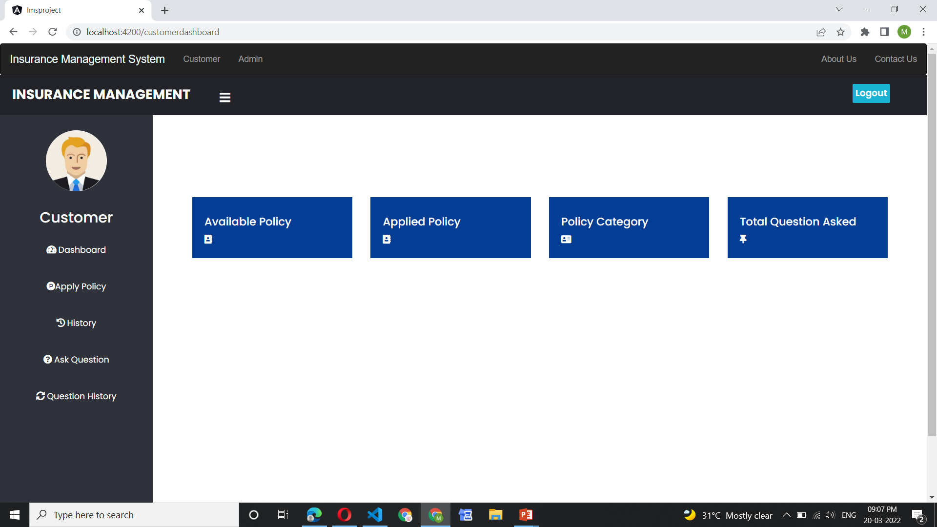

Slide 18
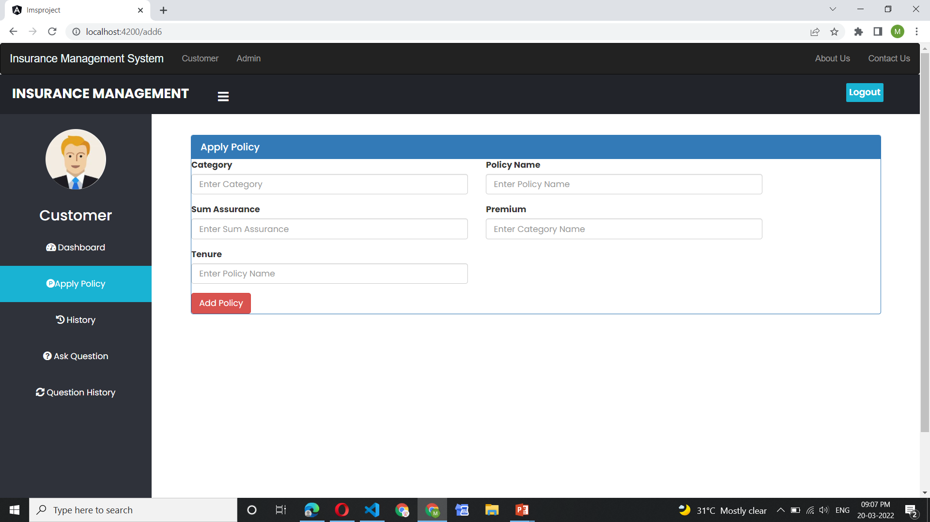

Slide 19
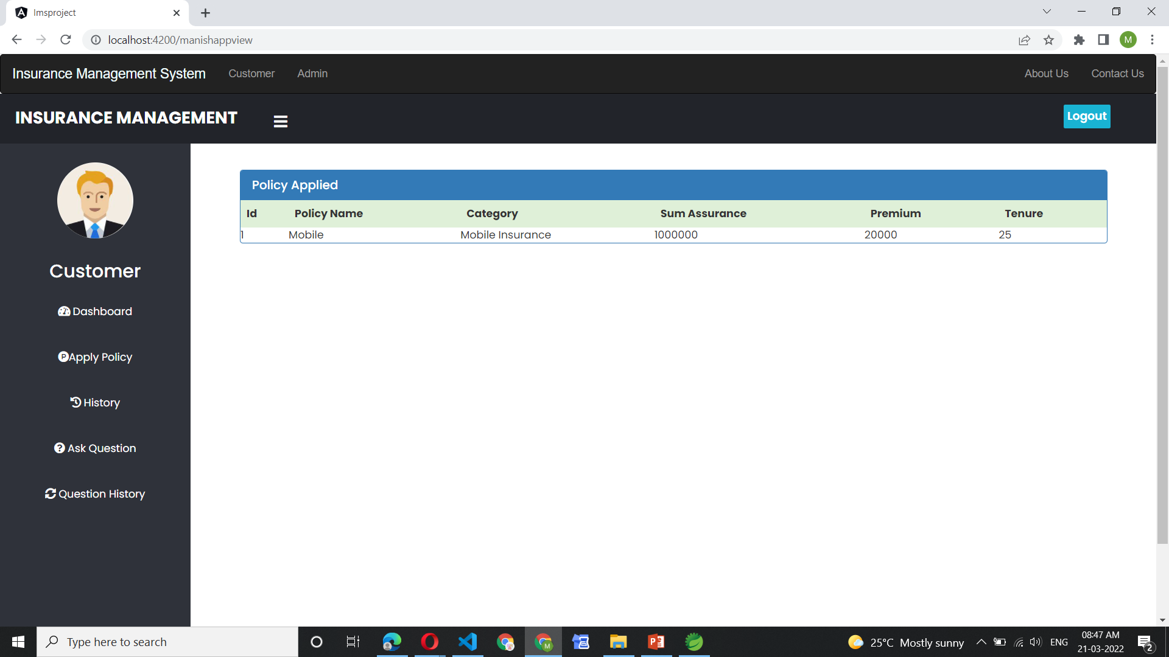
Applied Policy History

Slide 20
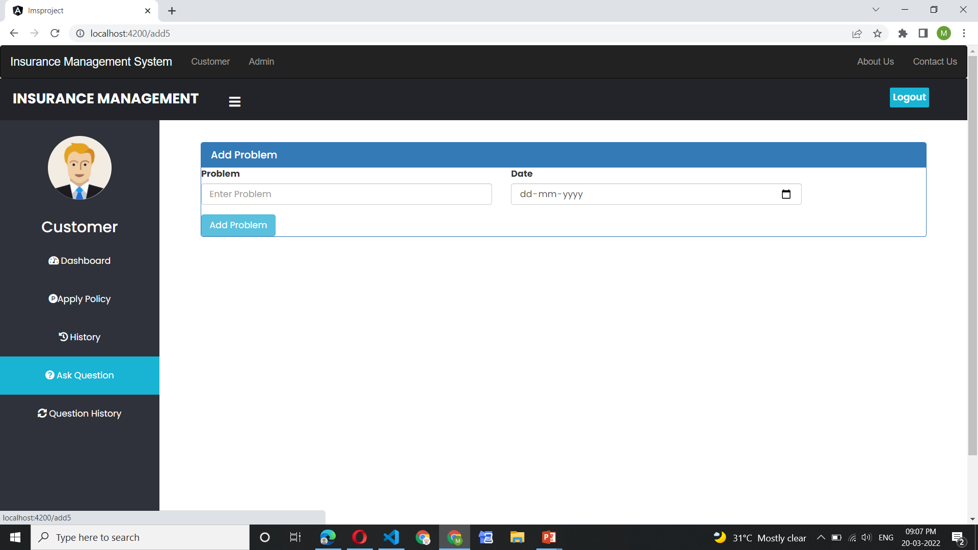
Ask Questions

Slide 21
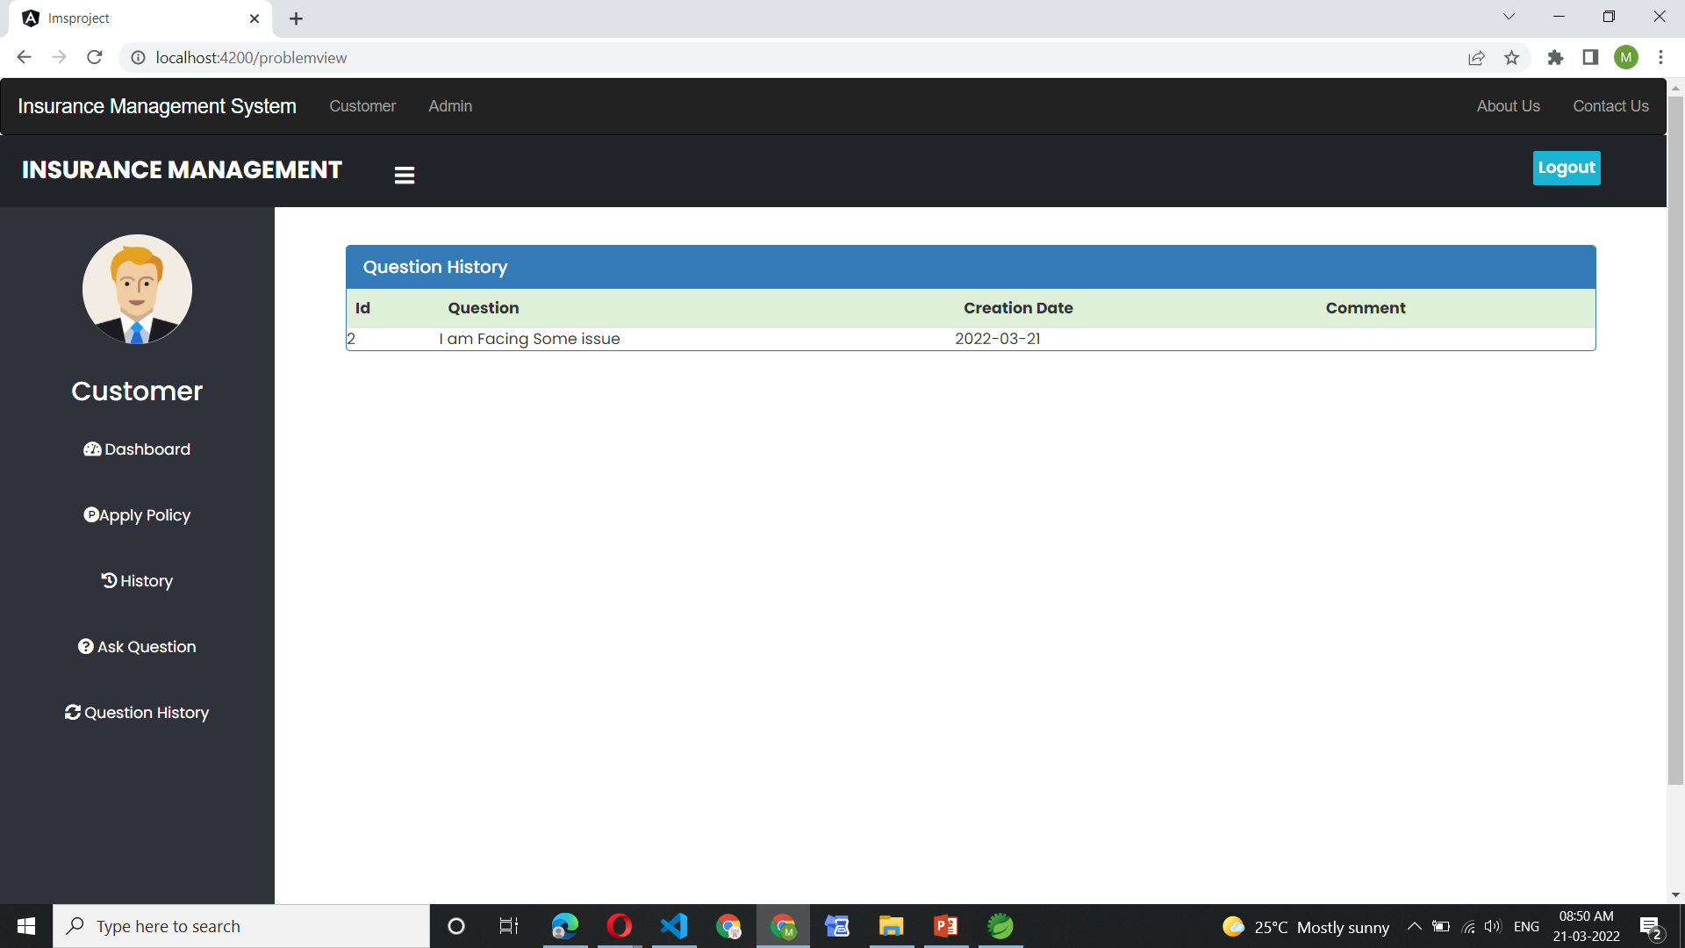
Ask Question History

Slide 22
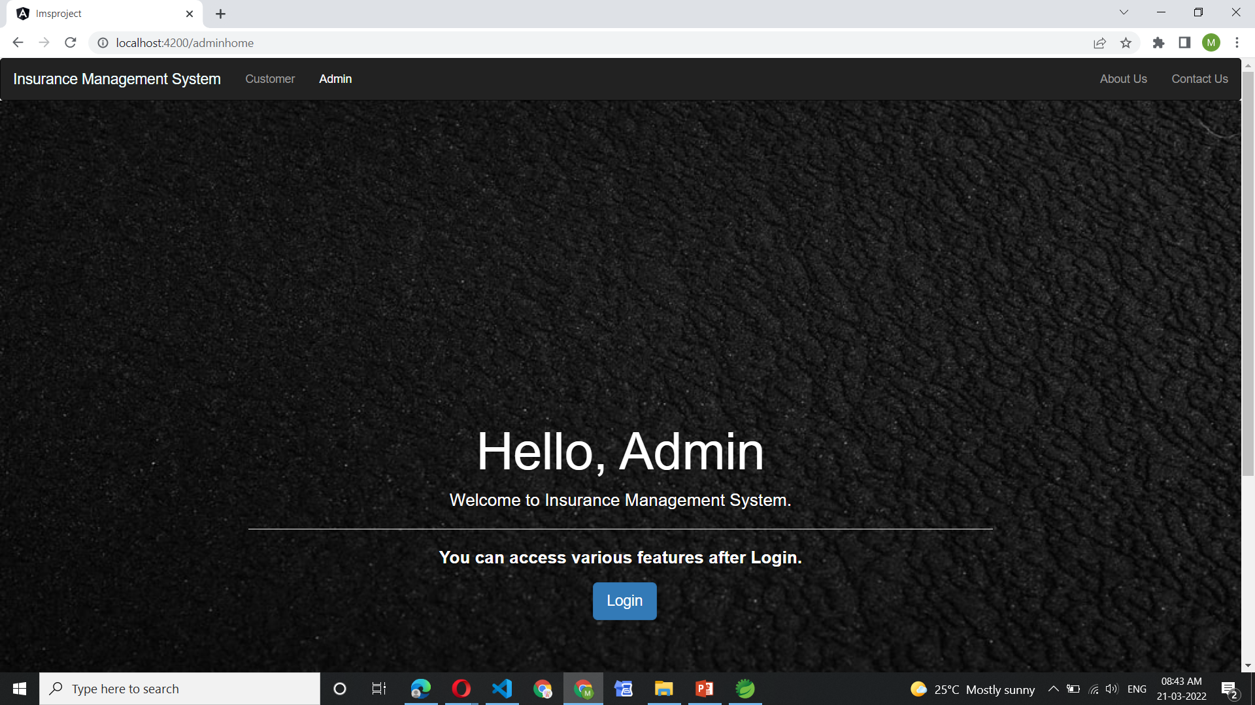
Login Page Admin

Slide 23

Admin Login

Slide 24
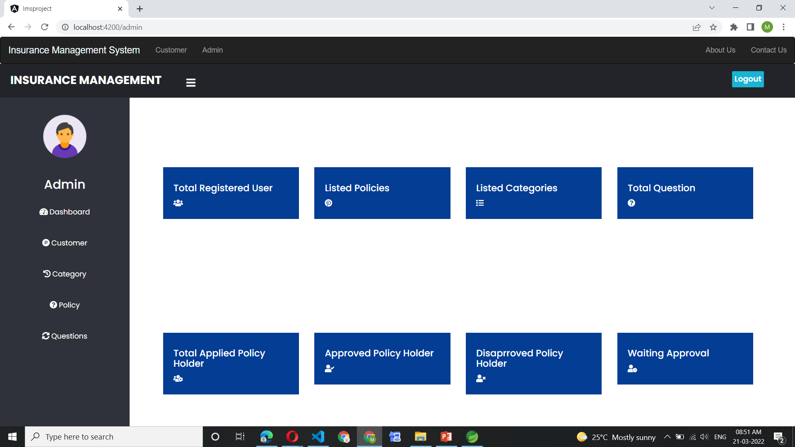
Admin Dashboard

Slide 25
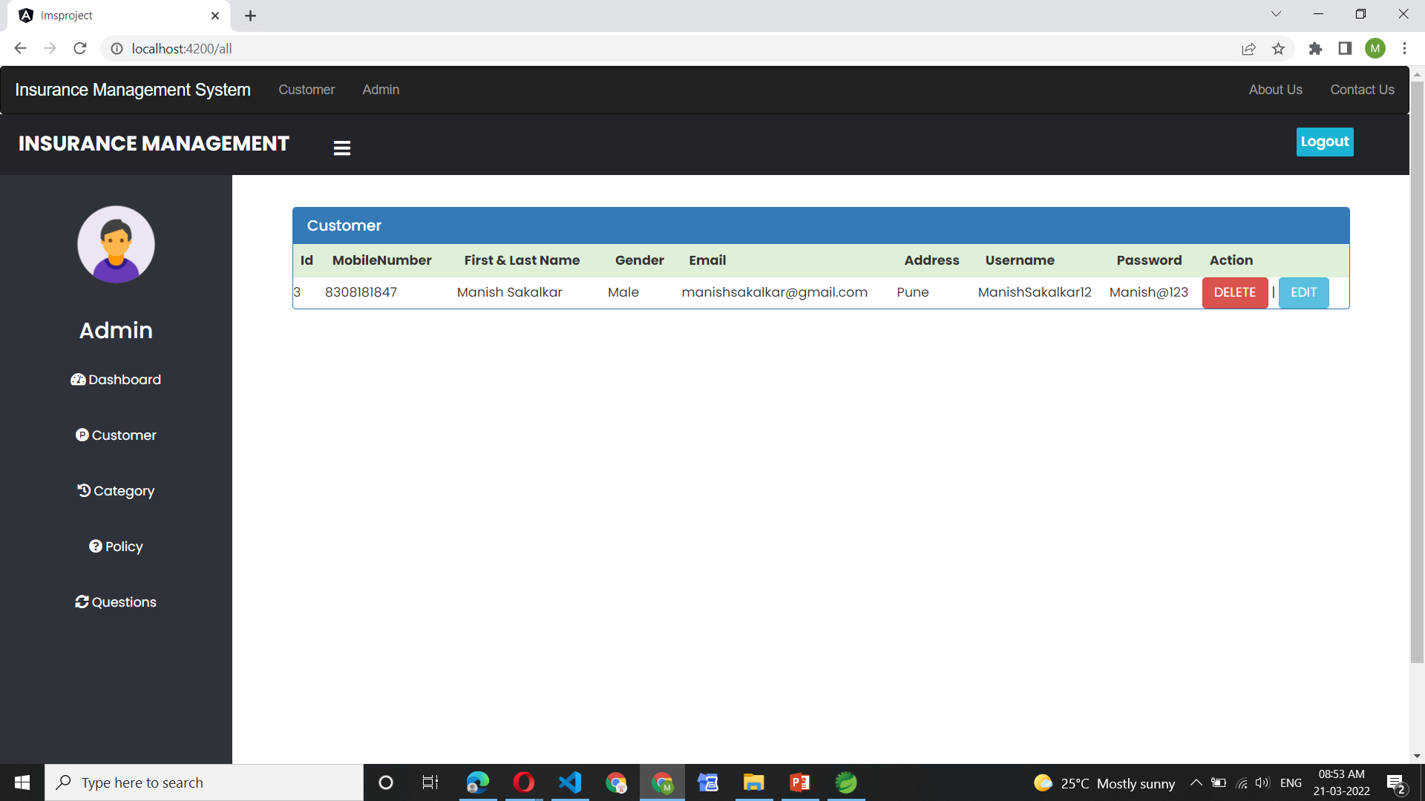
Customer All Data

Slide 26
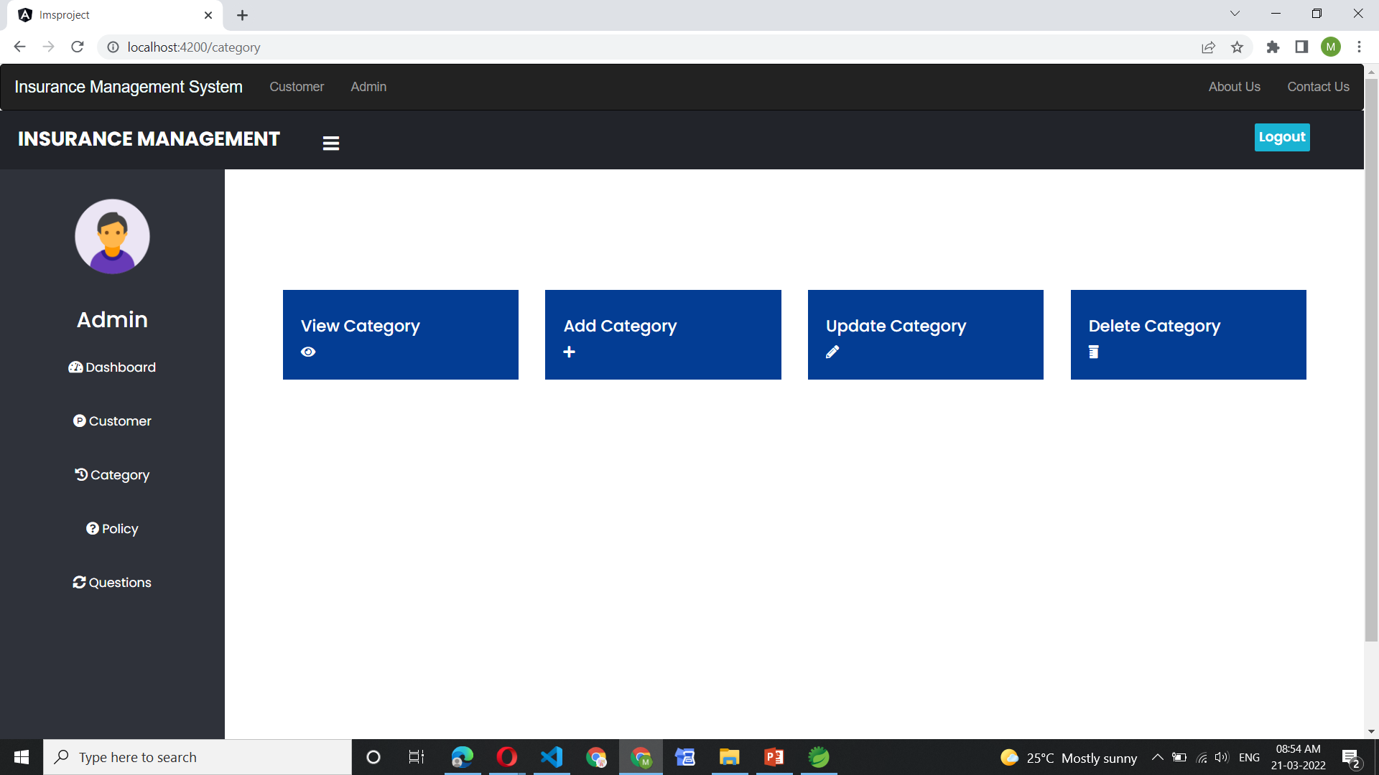
Category Page

Slide 27
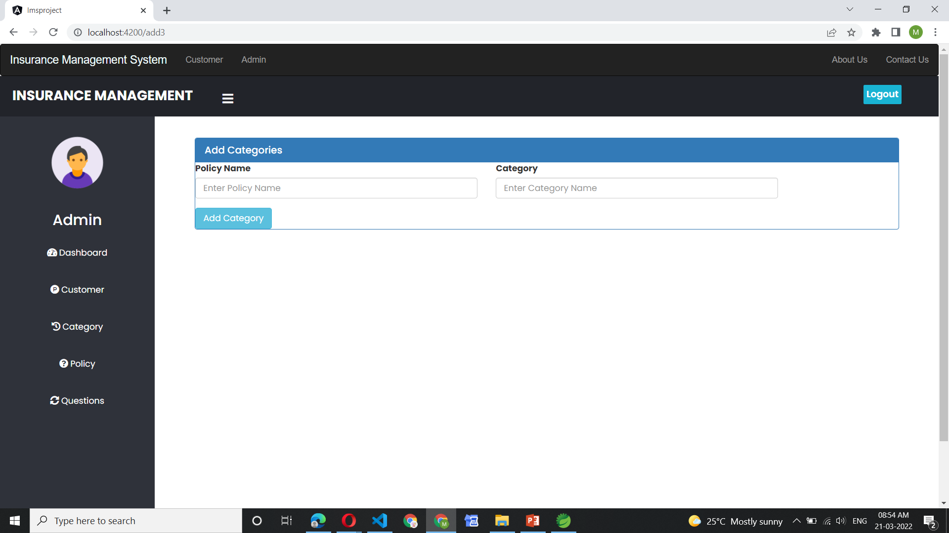
Add Categories

Slide 28
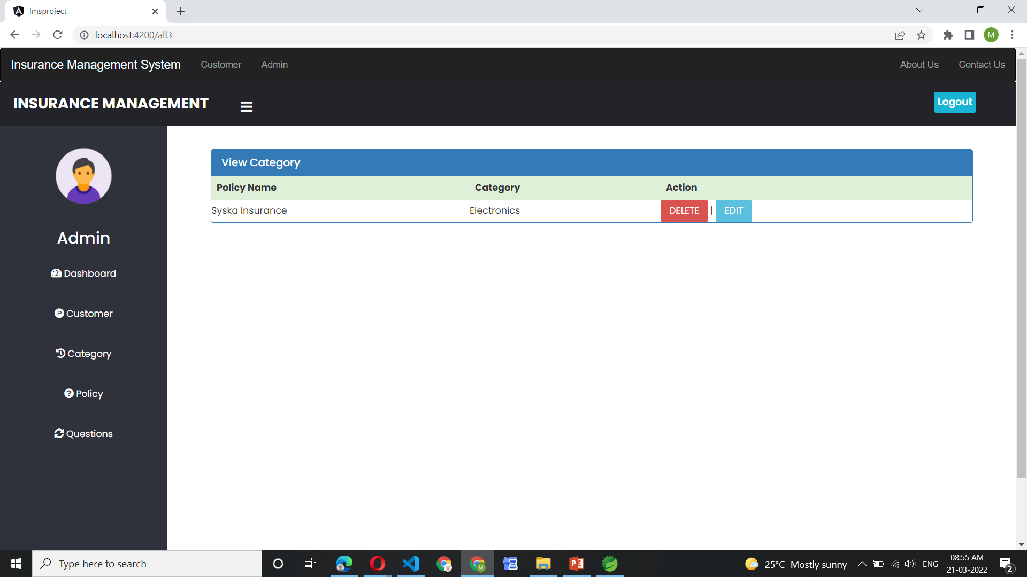
Category All Data

Slide 29
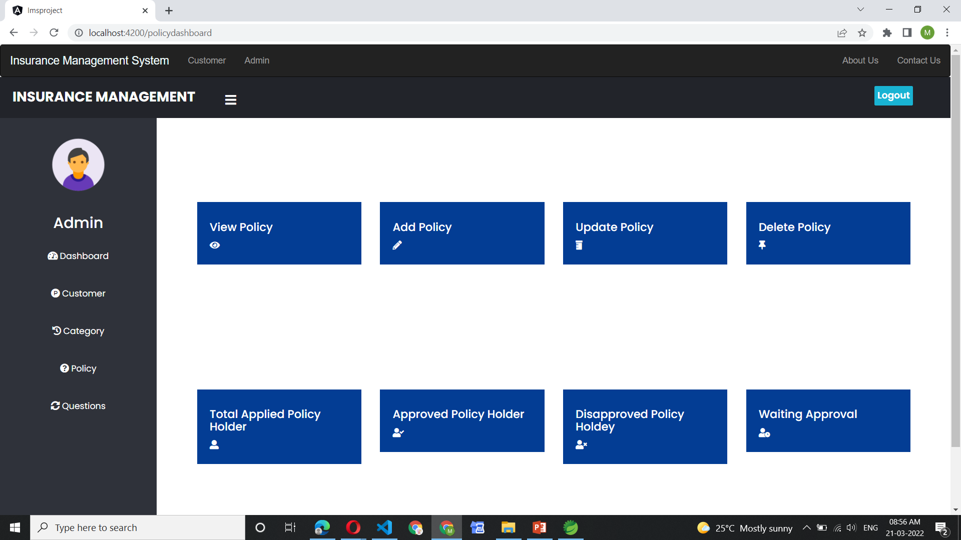
Policy Dashboard

Slide 30
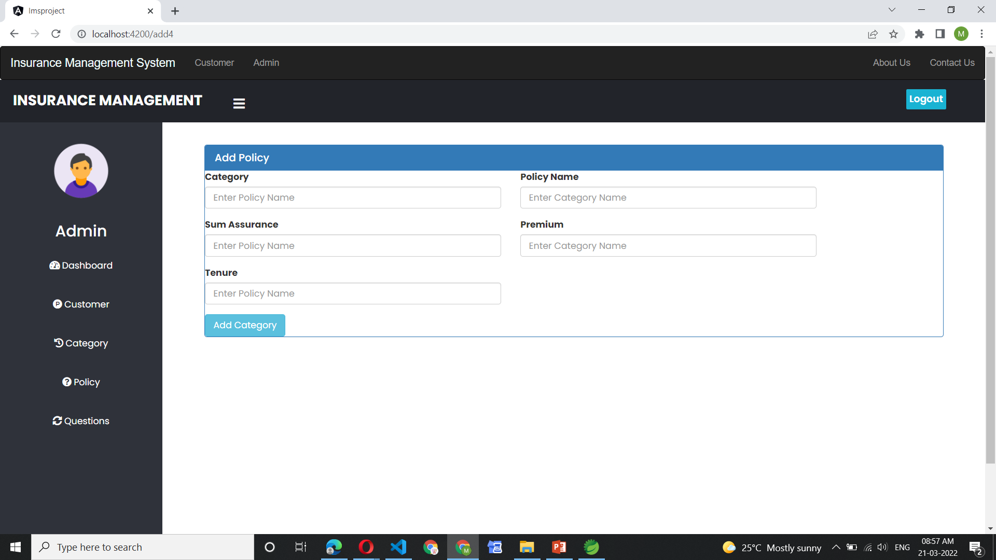

Slide 31
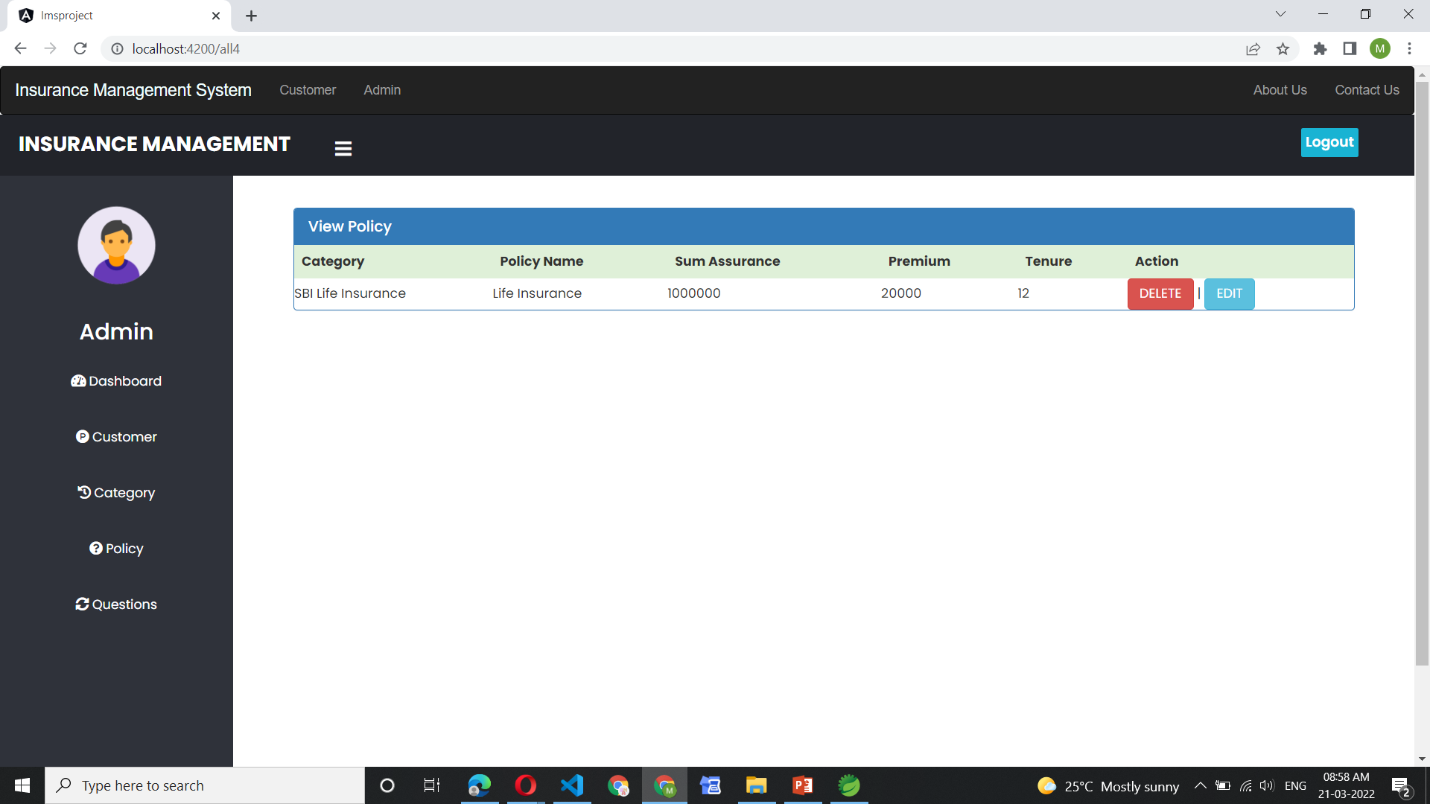
Policy All Data

Slide 32

Total Applied Policy Holder

Slide 33

Total Applied Policy Holder Data

Slide 34
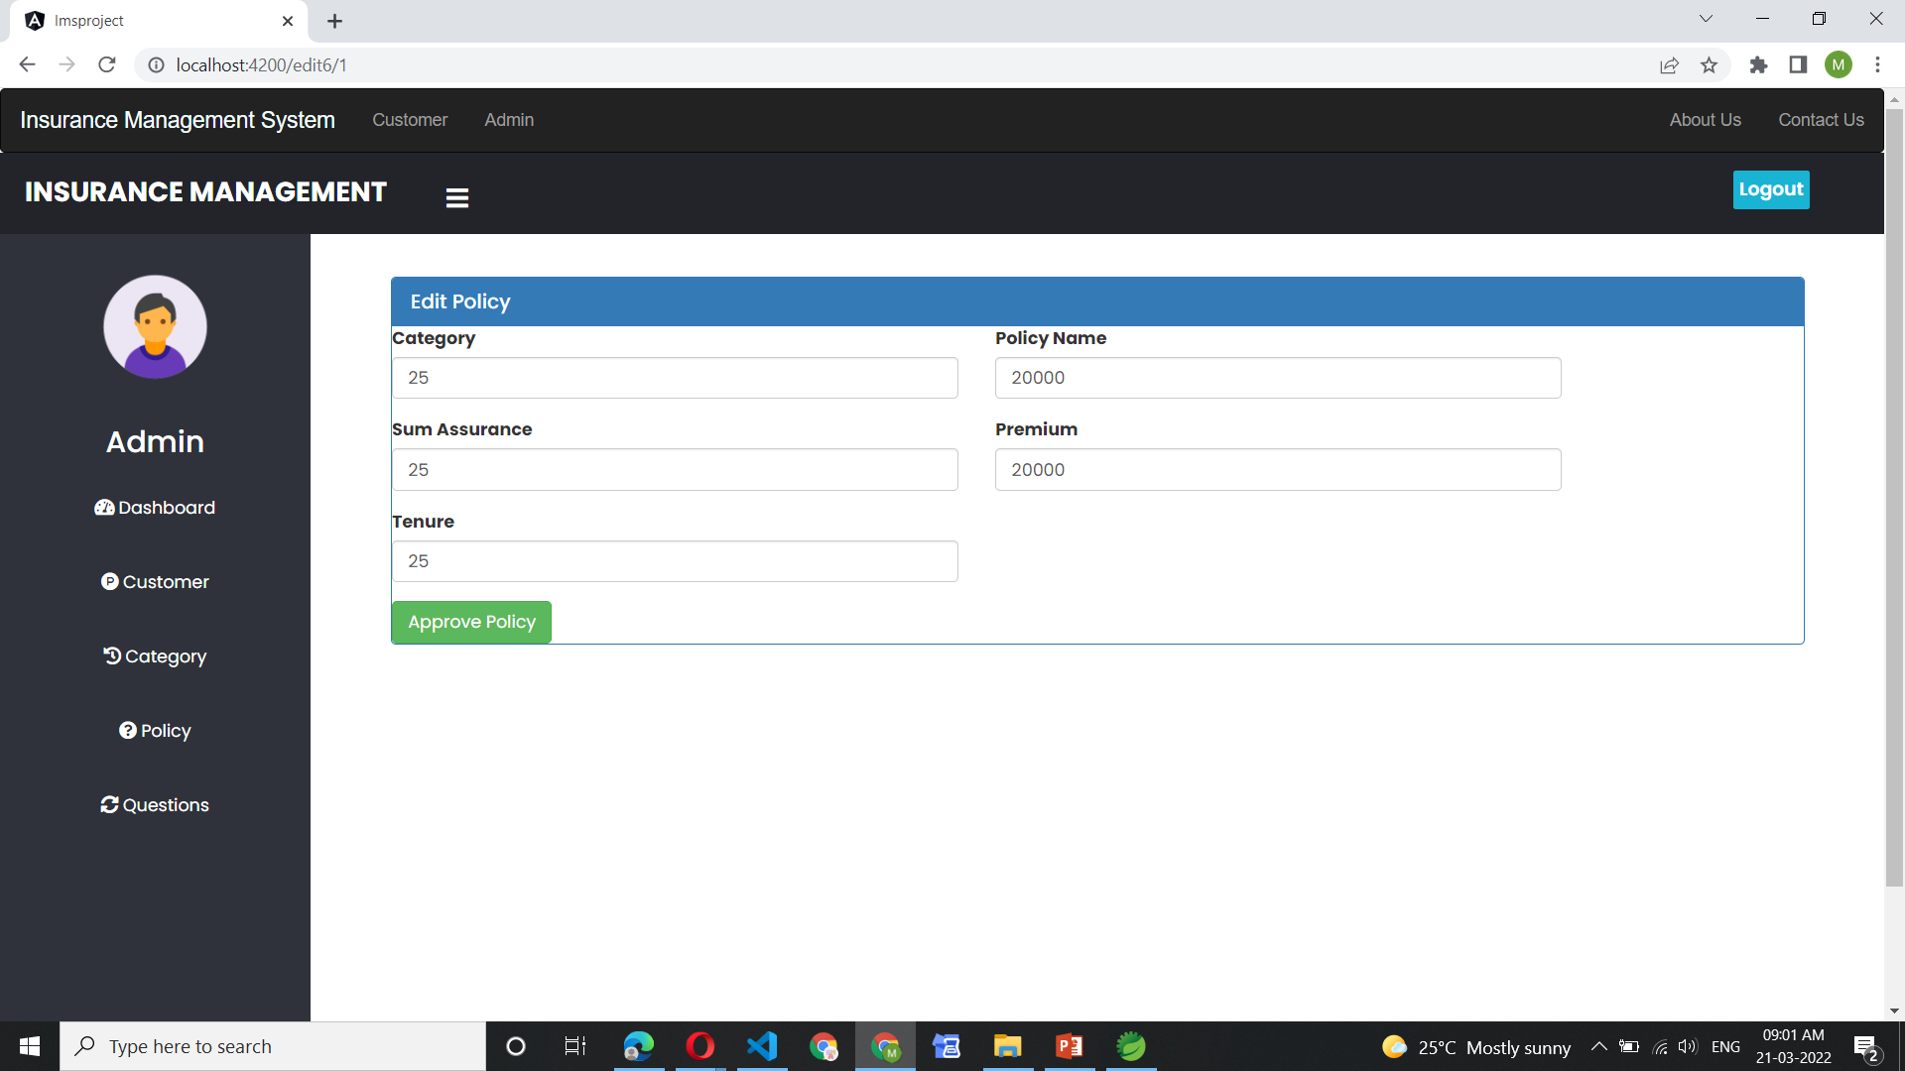
Approved Policy

Slide 35
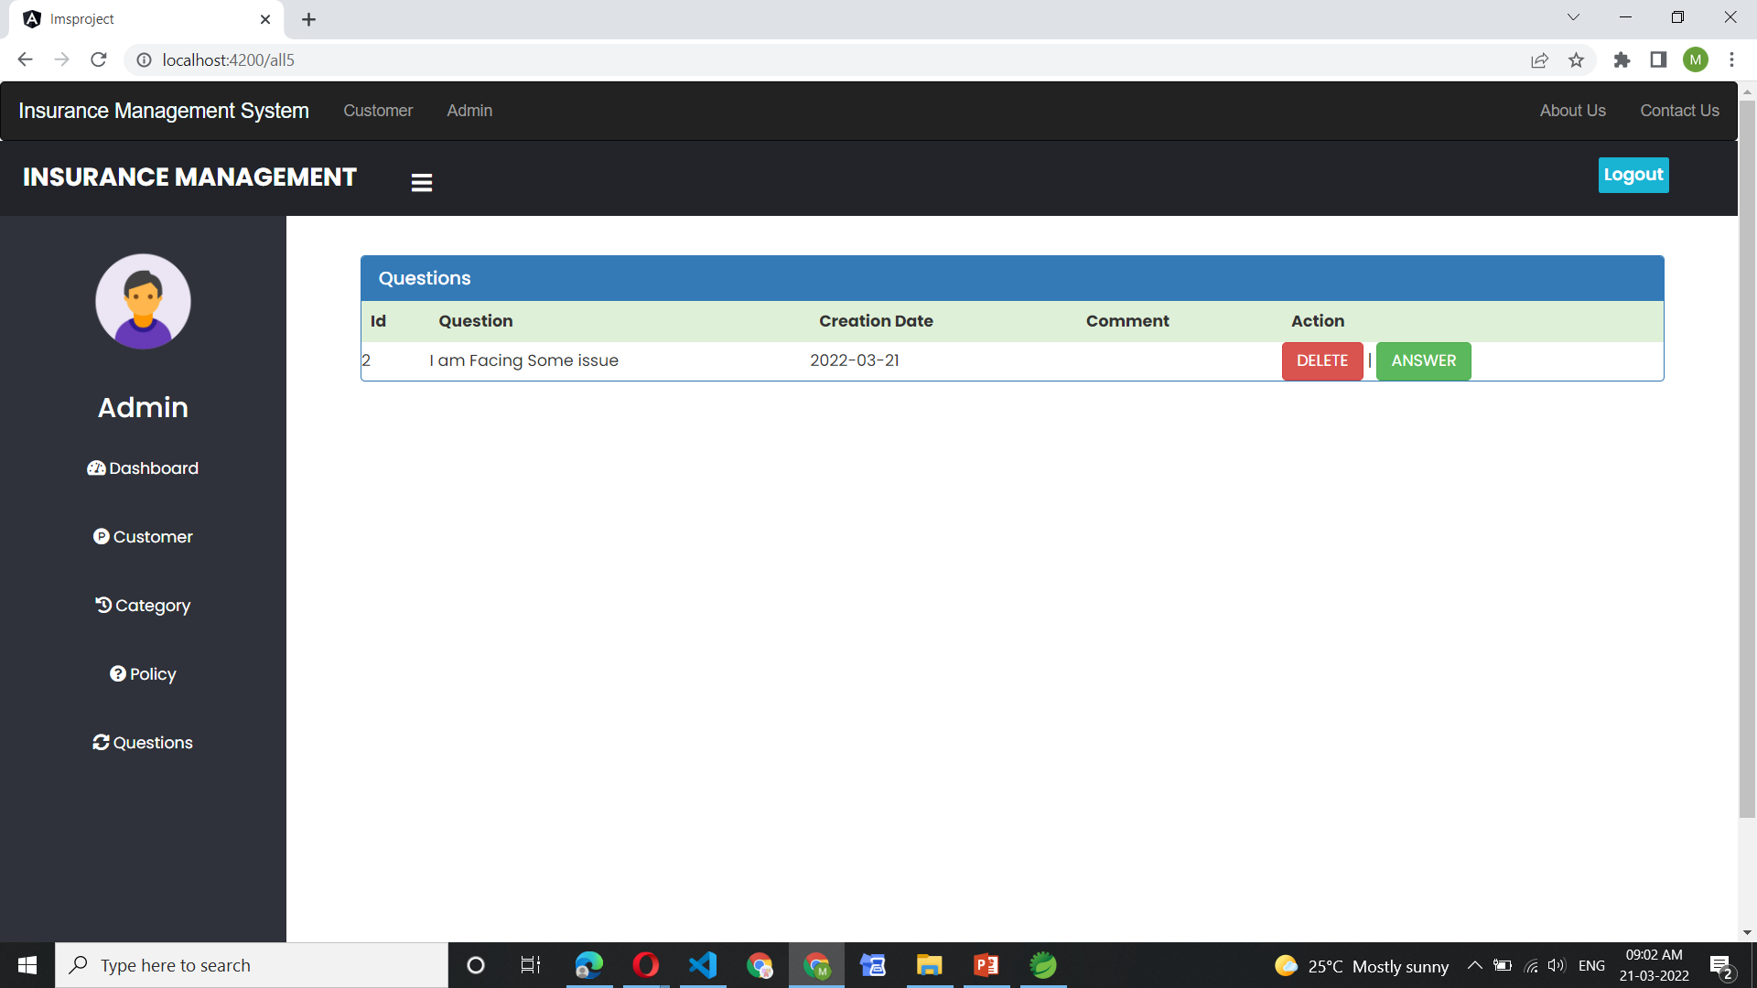
History Questions

Slide 36
Advantages
Financial Protection
Stability of living standards
Loan Facility
Tax Free Money

Slide 37
Disadvantages
Terms and Conditions
Long Legal Formalities
Fraud Agency
Not for all People

Slide 38
Conclusion
Since the advent of Online Insurance services in the Middle Ages Policy Agents and policy Holders have used paper-based instruments to move money between Insurance transactions. Everyone wants to lead the group. Hence, everyone is trying to make the best use of the Internet.

Slide 39
Future Scope
To make the system more convenient and flexible
To make the system more user friendly
Hassle free payment process
To make the system totally Paper Less

